Slide 1
Study of the interaction between human MKK7 and human gadd45B using ClusPro
EMBO Practical Course on
Computational analysis of protein-protein interactions:
From sequences to networks
28 September – 3 October 2015
TGAC, Norwich, UK
Allegra Via
allegra.via@gmail.com
allegra.via@uniroma1.it

Slide 2
Where can we find the spatial coordinates of proteins?

Slide 3
HEADER TRANSFERASE 15-SEP-06 2DYL
TITLE CRYSTAL STRUCTURE OF HUMAN MITOGEN-ACTIVATED PROTEIN KINASE
TITLE 2 KINASE 7 ACTIVATED MUTANT (S287D, T291D)
COMPND MOL_ID: 1;
COMPND 2 MOLECULE: DUAL SPECIFICITY MITOGEN-ACTIVATED PROTEIN
COMPND 3 KINASE KINASE 7;
COMPND 4 CHAIN: A;
SOURCE 2 ORGANISM_SCIENTIFIC: HOMO SAPIENS;
....
ATOM 1 N THR A 119 35.046 46.717 32.662 1.00 72.79
ATOM 2 CA THR A 119 34.549 45.371 32.236 1.00 74.23
ATOM 3 C THR A 119 35.039 44.281 33.197 1.00 73.49
ATOM 4 O THR A 119 34.438 43.213 33.291 1.00 77.28
ATOM 5 CB THR A 119 35.029 45.003 30.786 1.00 77.83
ATOM 6 OG1 THR A 119 34.699 46.059 29.872 1.00 72.64
ATOM 7 CG2 THR A 119 34.359 43.698 30.309 1.00 75.24
ATOM 8 N GLY A 120 36.130 44.548 33.908 1.00 69.95
ATOM 9 CA GLY A 120 36.661 43.566 34.835 1.00 67.79
ATOM 10 C GLY A 120 36.750 44.131 36.239 1.00 70.21
ATOM 11 O GLY A 120 36.963 45.326 36.414 1.00 73.35
ATOM 12 N TYR A 121 36.574 43.274 37.239 1.00 64.91
ATOM 13 CA TYR A 121 36.645 43.669 38.642 1.00 61.51
ATOM 14 C TYR A 121 35.441 44.441 39.170 1.00 58.52
ATOM 15 O TYR A 121 35.574 45.348 39.996 1.00 59.66
ATOM 16 CB TYR A 121 37.937 44.452 38.908 1.00 75.43
...

Slide 4
What can we do when the coordinates are not available?
540.052 (SwissProt) + 33.995.348 (TrEMBL) May 2013
90.424 (PDB), 23.887 unique(<30% SeqId) May 2013
The difference between the number of sequences and structures is growing

Slide 5
Computational approaches
Fast (minutes/hours), cheap (PC)
Correct solutions in ~60% of cases
Low risolution but often sufficient to many purposes
Is it possible to predict a protein structure from its sequence?

Slide 6
Homology modelling
The structure of a protein is uniquely determined by its amino acid
Therefore the sequence should, in theory, contain enough information to obtain the structure
Similar sequences have been found to adopt practically identical structures while distantly related sequences can still fold into similar structures

Slide 7
Chothia et al. 1986; Sander et al. 1991; Rost 1999

Slide 8
Predictive methods
Comparative modeling > 30% identity
Threading/Fold recognition 0 – 30% identity
Ab initio/de novo no homologous

Slide 9
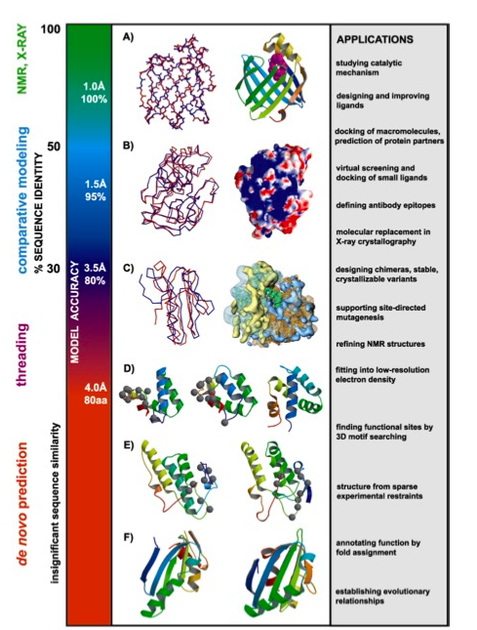

Slide 10
Sequence identity | Model quality
60-100% | Comparable with average resolution NMR. Substrate specificity
30-60% | Starting point for site-directed mutagenesis studies.
< 30% | Serious errors

Slide 11
Template recognition and initial alignment
Alignment correction
Backbone generation
Loop modeling
Side chain modeling
Model optimisation
Model validation (by hand or using different servers)
Iteration to correct mistakes (if any)

Slide 12
Step 1: Template recognition and initial alignment
To identify the template, the program compares the query sequence to all the sequences of known structures in the PDB (e.g. BLAST)
Usually, the template structure with the highest sequence identity and coverage will be the first option
Other considerations:
conformational state (i.e. active or inactive)
present co-factors
other molecules or multimeric complexes
It possible to choose multiple templates and build multiple models
It is possible to combine multiple templates into one structure that is used for modeling

Slide 13
Step 2: Alignment correction
Having identified one or more possible modeling templates using the initial screen described above, more sophisticated methods are needed to arrive at a better alignment

Slide 14
Step 3: Backbone generation
When the alignment is ready, the actual model building can start.
Creating the backbone is trivial for most of the model: one simply transfers the coordinates of those template residues that show up in the alignment with the model
If two aligned residues differ, the backbone coordinates for N, Cα, C and O and often also the Cβ can be copied.
Conserved residues can be copied completely to provide an initial guess.

Slide 15
Step 4: Loop modeling
For the majority of homology model building cases, the alignment between model and template sequence contains gaps.
Gaps in the model-sequence are addressed by omitting residues from the template
Gaps in the template sequences are treated by inserting missing residues the into the continuous backbone
Changes in loop conformation are notoriously hard to predict

Slide 16
Loop modeling
A search is made through the PDB for known loops containing endpoints that match the residues between which the loop is to be inserted.
loop
pre-loop
post-loop

Slide 17
Notes:
15

Slide 18
Notes:
16

Slide 19
Step 5: Side chain modeling
Libraries of common rotamers extracted from high resolution X-ray structures are often used to position side chains
The various rotamers are successively explored and scored with a variety of energy functions

Slide 20
Step 6: Model optimisation
To predict the side chain rotamers with high accuracy, we need the correct backbone, which in turn depends on the rotamers and their packing
The common approach to address this problem is to iteratively model the rotamers and backbone structure
First, we predict the rotamers, then remodel the backbone to accommodate rotamers, followed by a round of refitting the rotamers to the new backbone
This process is repeated until the solution converges
This boils down to a series of rotamer prediction and energy minimisation steps.

Slide 21
Step 7: Model validation
Every protein structure contains errors, and homology models are no exception.
The number of errors (for a given method) mainly depends on two values:
The percentage sequence identity between template and model-sequence
The number of errors in the template.
There are two principally different ways to estimate errors in a structure
Calculating the model's energy based on a force field
Determination of normality indices that describe how well a given characteristic of the model resembles the same characteristic in real structures

Slide 22
Step 8: Iteration to correct mistakes
When errors in the model are recognised and located, they can be corrected by iterating portions of the homology modeling process.
Small errors that are introduced during the optimisation step can be removed by running a shorter molecular dynamics simulation
A error in a loop can be corrected by choosing another loop conformation in the loop modeling step
Large mistakes in the backbone conformation sometimes require the complete process to be repeated with another alignment or even with a different template

Slide 31
>sp|O75293|GA45B_HUMAN Growth arrest and DNA damage-inducible protein GADD45 beta OS=Homo sapiens GN=GADD45B PE=1 SV=1
MTLEELVACDNAAQKMQTVTAAVEELLVAAQRQDRLTVGVYESAKLMNVDPDSVVLCLLA
IDEEEEDDIALQIHFTLIQSFCCDNDINIVRVSGMQRLAQLLGEPAETQGTTEARDLHCL
LVTNPHTDAWKSHGLVEVASYCEESRGNNQWVPYISLQER

Slide 36
>P1;sp|O75293|GA45B_HUMAN
sequence:sp|O75293|GA45B_HUMAN: 1: : 160: :Growth arrest and DNA damage-inducible protein GADD45 beta OS=Homo sapiens GN=GADD45B PE=1 SV=1: : 0.00: 0.00
MTLEELVACDNAAQKMQTVTAAVEELLVAAQRQDRLTVGVYESAKLMNVDPDSVVLCLLAIDEEEEDDIALQIHFTLIQSFCCDNDINIVRVSGMQRLAQ
LLGEPAETQGTTEARDLHCLLVTNPHTDAWKSHGLVEVASYCEESRGNNQWVPYISLQER*
>P1;3ffm_A
structureX:3ffm_A: :A: :A:Growth arrest and DNA-damage-inducible protein GADD45 gamma; beta-turn-helix, cell cycle; 2.30A {Homo sapiens}:Homo sapiens:2.30:0.23
-----------STARMQGAGKALHELLLSAQRQGCLTAGVYESAKVLNVDPDNVTFCVLAAGEEDEGDIALQIHFTLIQAFCCENDIDIVRVGDVQRLAA
IVGA--GEEA-GAPGDLHCILISNPNEDAWKDPALEKLSLFCEESRSVNDWVPSITLPE-*

Slide 41
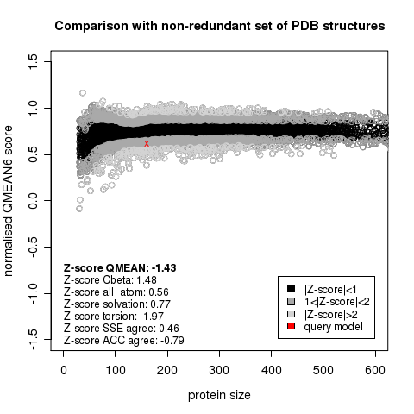

Slide 42
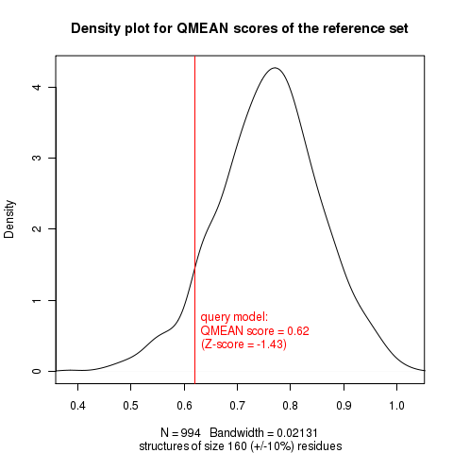

Slide 43
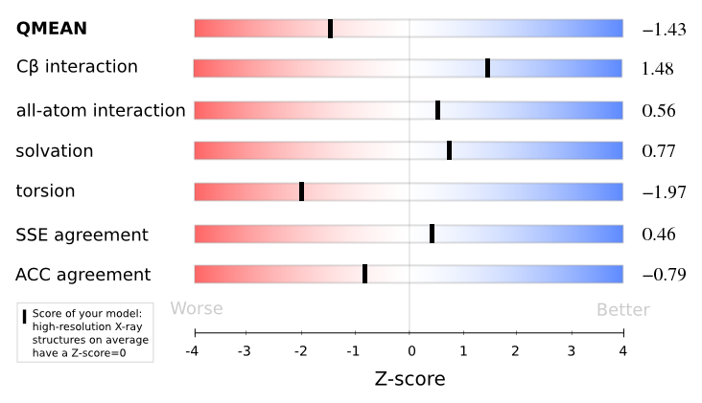

Slide 44
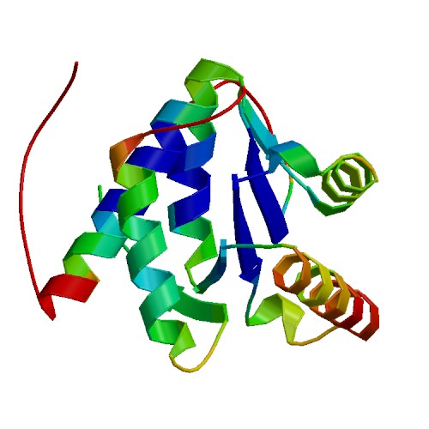

Slide 45
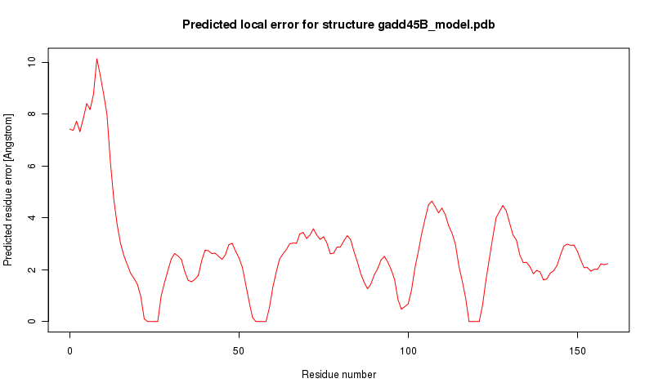

Slide 46
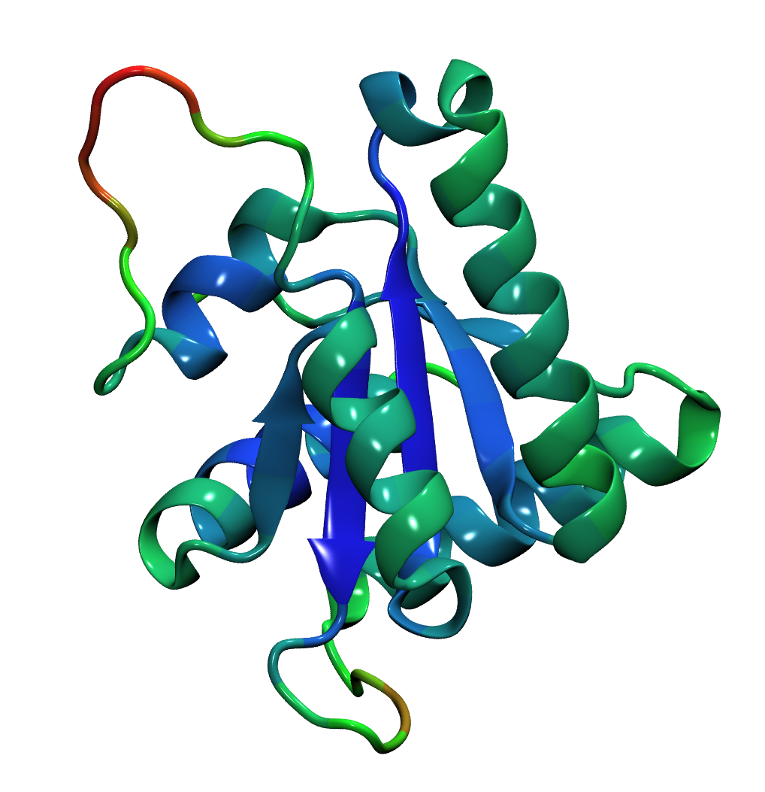
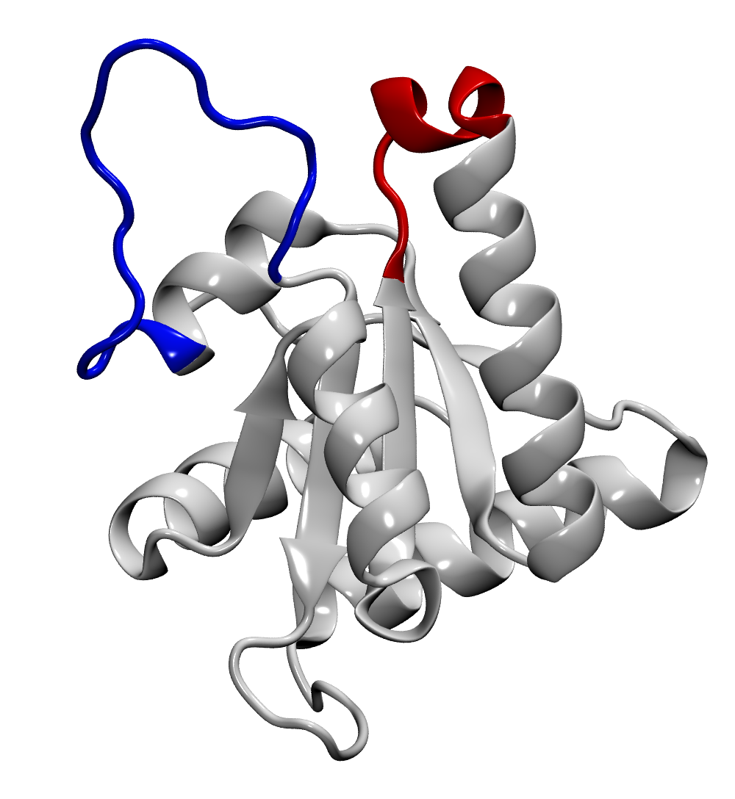
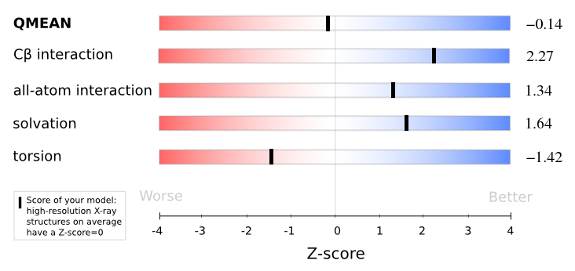
Gadd45β protein structure prediction and assessment
http://swissmodel.expasy.org/qmean/cgi/index.cgi
Gadd45β QMEAN score = 0.781
(QMEAN score: score of the whole model reflecting the predicted model reliability ranging from 0 to 1)
Gadd45β QMEAN Z-score= -0.14
(High-resolution X-ray structures on average have a Z-score = 0)

Slide 49
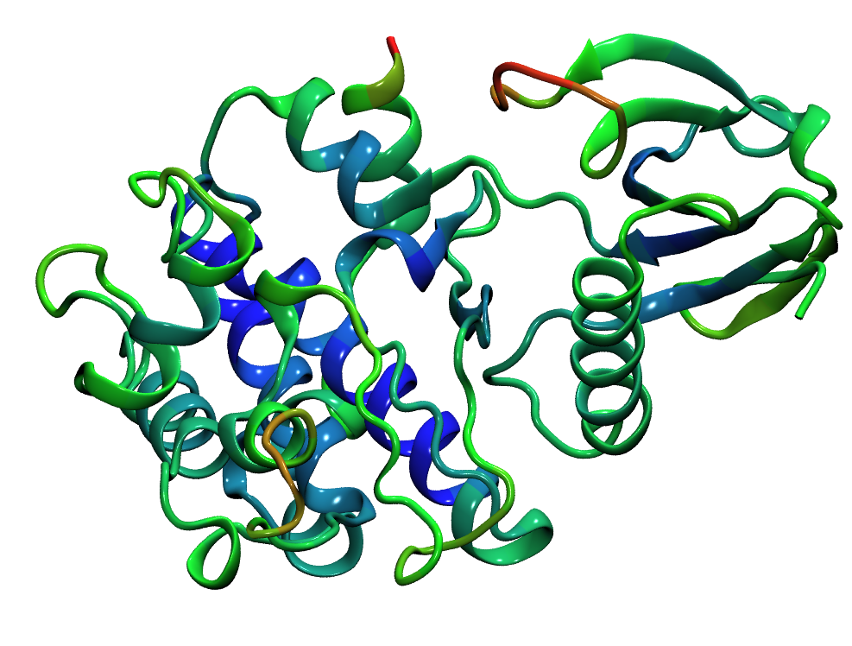
Unbound protein used for docking experiment
MKK7 solved structure (PDB code: 2dyl)
Gadd45β protein structure model

Slide 54
Use of ClusPro restraints
If you have knowledge about residues that should be close together in the interface, you can make a restraints file and use it to only produce results which satisfy your restraints.
Each restraint specifies a pair of residues, one from the receptor and one from the ligand, and an acceptable distance range for the restraint to be satisfied.
Restraints can combined into restraint groups, and groups into a restraint set, which allows users to specify some logic about how many restraints are required to be satisfied.
Restraints can either be in an AIR format, or in JSON format.
ClusPro provides a tool for generating restraints in JSON format.
Create a restraint, save it into a file with .json extension, upload the file in the ClusPro Restraint section

